Slide 1
Data 603 Statistical Modelling with Data
(Week 2)
Dr. Qingrun Zhang
Assistant Professor
Department of Mathematics and Statistics
University of Calgary

Slide 2
MULTIPLE LINEAR REGRESSION
PART II: MODEL BUILDING IN MULTIPLE REGRESSION

Slide 3

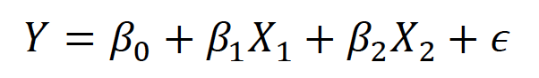
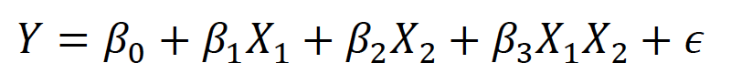
An Interaction Model with Quantitative Predictors
Standard linear regression model
Regression model with interaction term

Slide 4
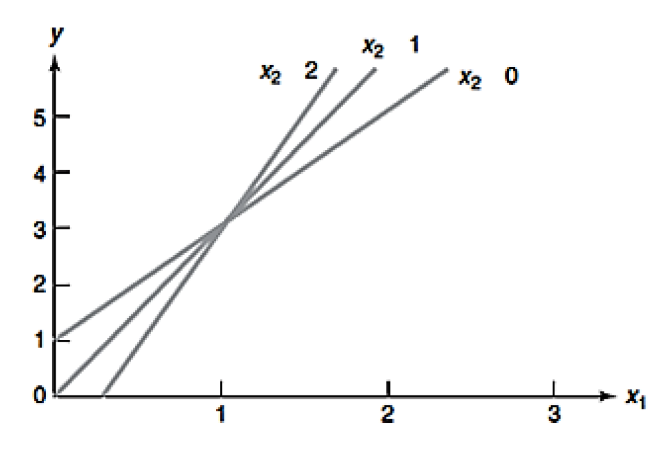
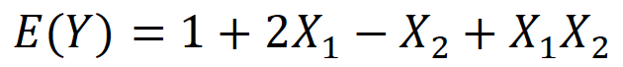
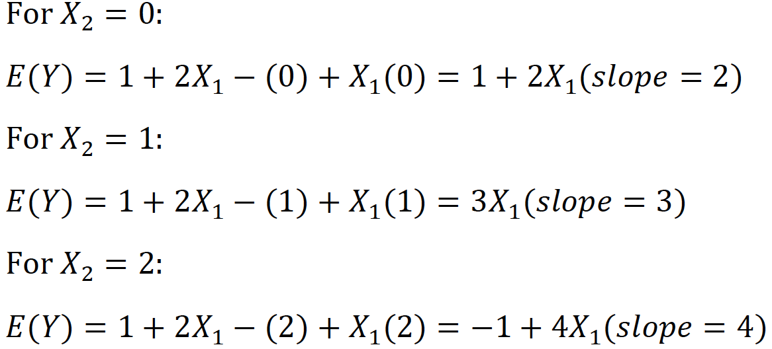
An example

Slide 5
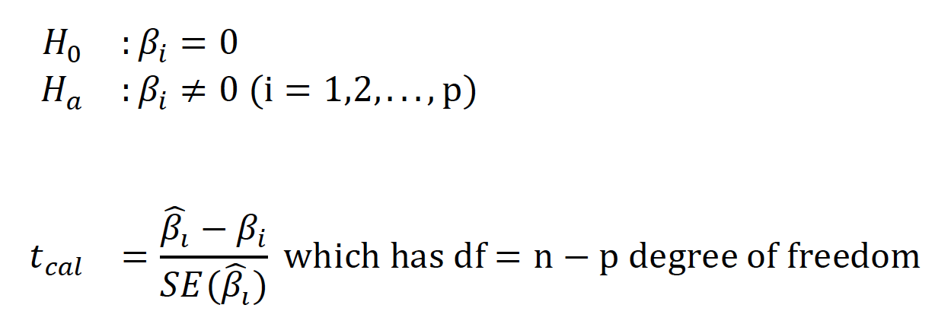
Testing for Interaction in Multiple Regression

Slide 6
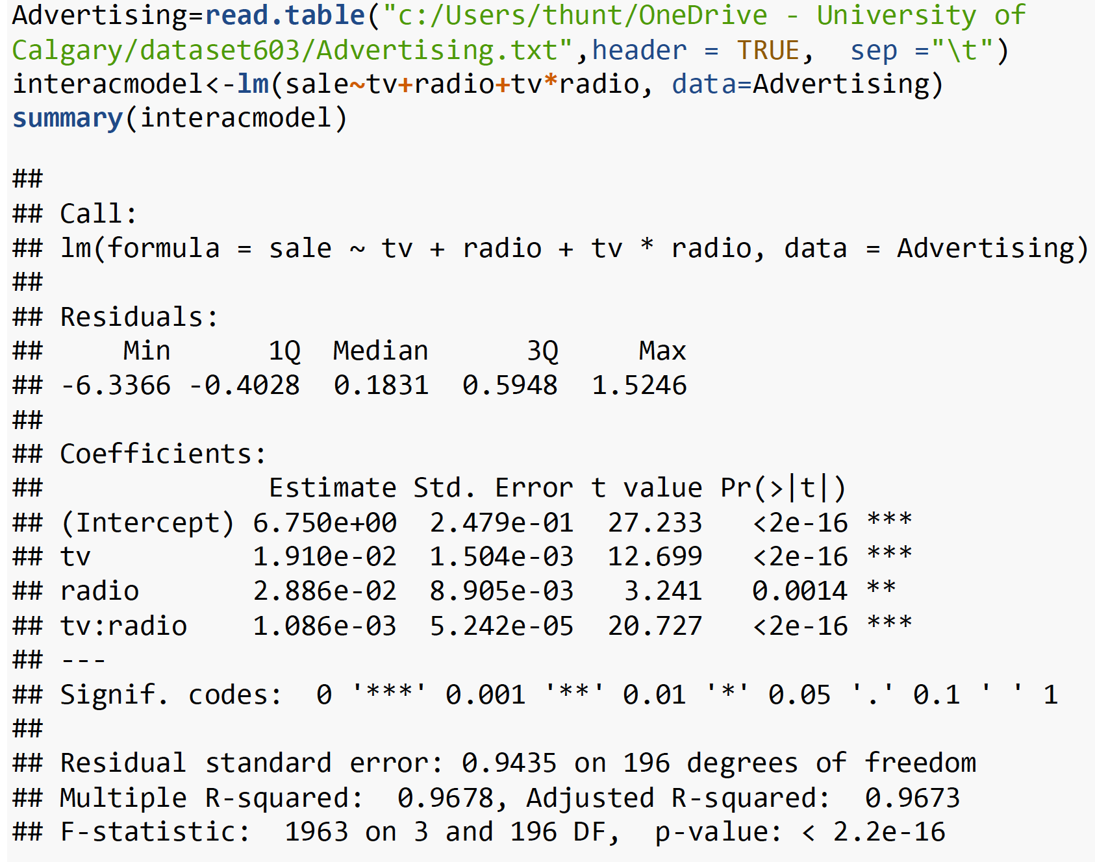
Try ANOVA?

Slide 7
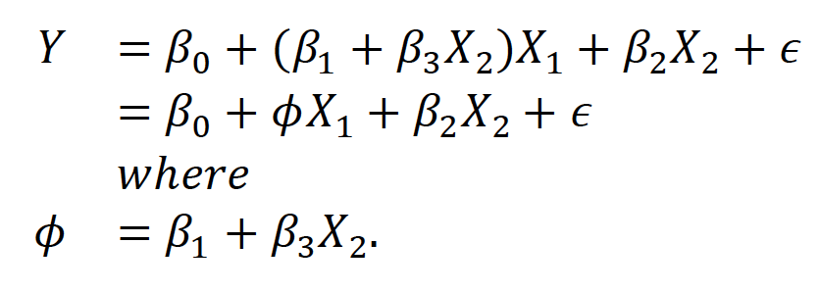
Interpreting Coefficients of Predictor Variables
Since 𝜙 changes with 𝑋₂, the effect of 𝑋₁ on 𝑌 is no longer constant: adjusting 𝑋₂ will change the impact of 𝑋₁ on 𝑌

Slide 8

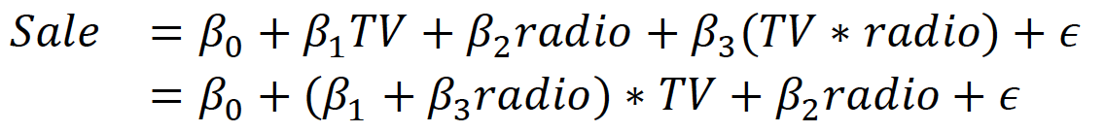
Examples
Productivities based on # of production line and # of workers
Advertising data

Slide 9
In-class Practice Problem #4 and #5

Slide 10
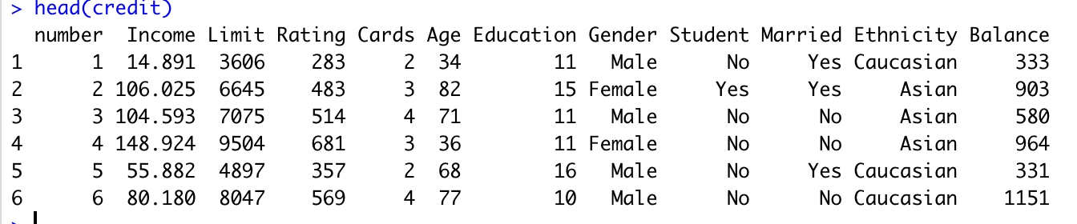
Multiple Regression with Qualitative (Dummy) Variable Models
a categorical variable with 𝑘 levels will be transformed into 𝑘−1 variables each with two levels
For example: Gender, we have two categories, so we have 2-1 =1 dummy variables.. For ethnicity, we have 3 categories, so we have 3-1=2 dummy variables.

Slide 11
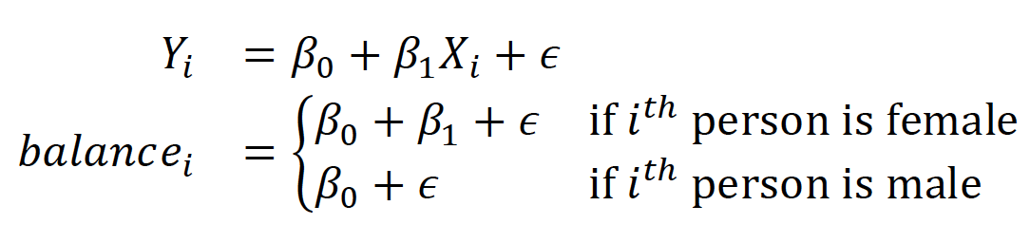
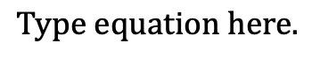
Dummy Coding
Gender | X1
Male | 1
Female | 0
ethnicity | X1 | X2
African American | 1 | 0
Asian | 0 | 1
Caucasian | 0 | 0

Slide 12
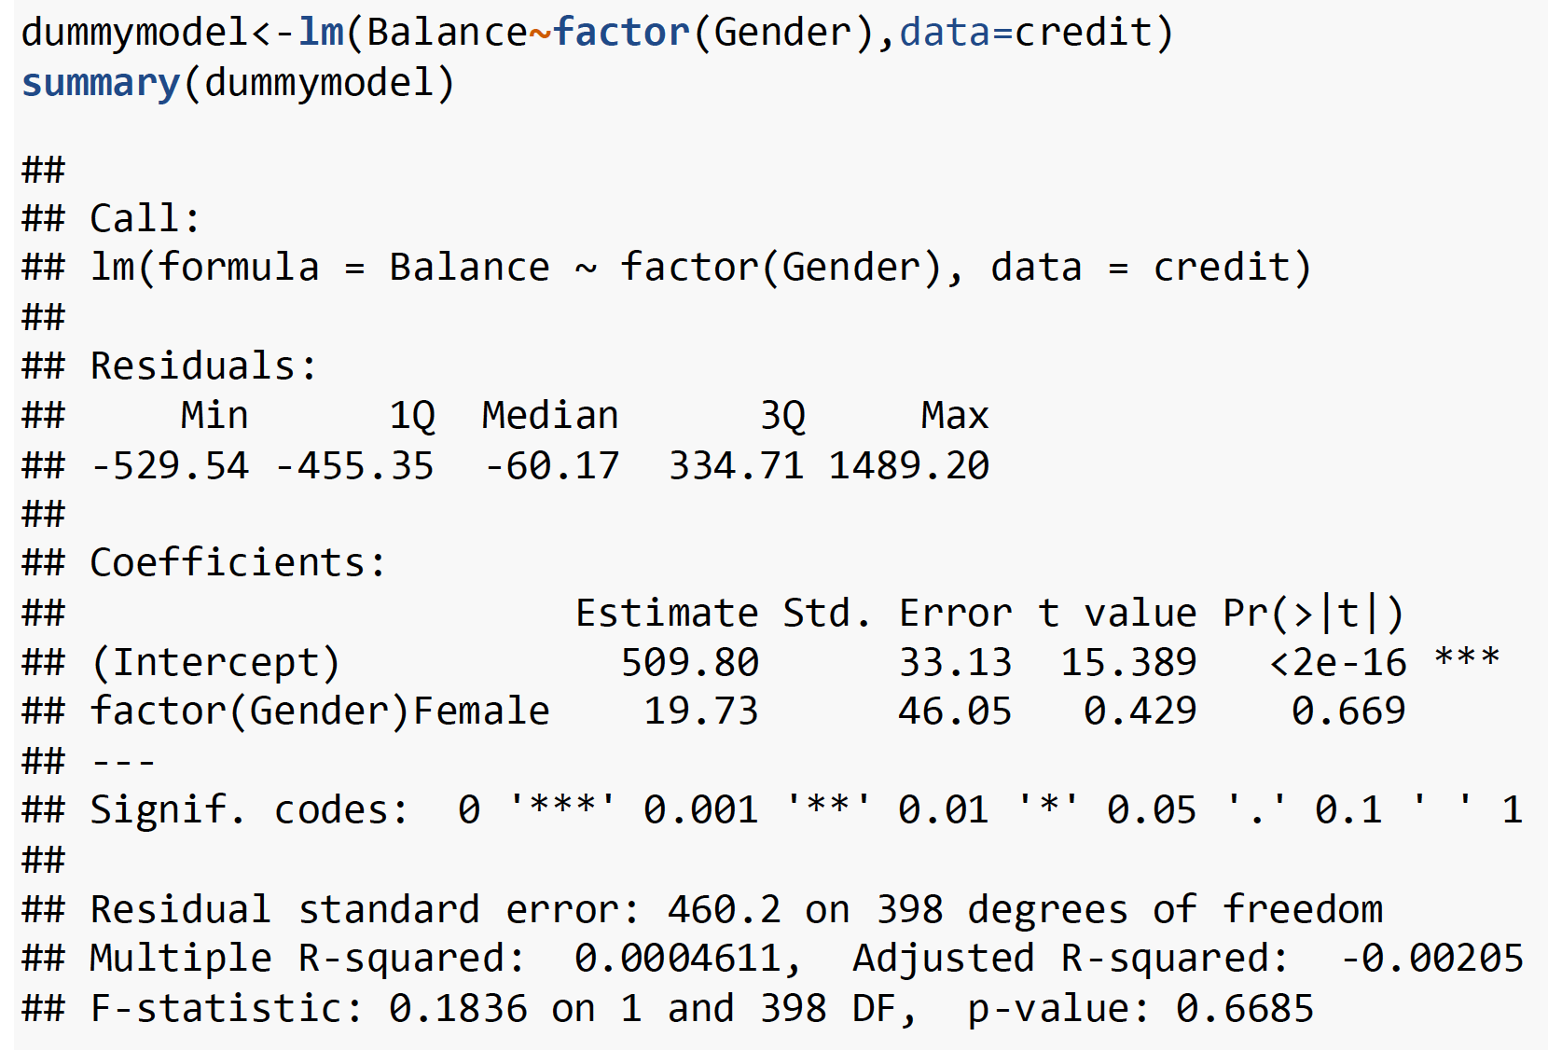

Slide 13
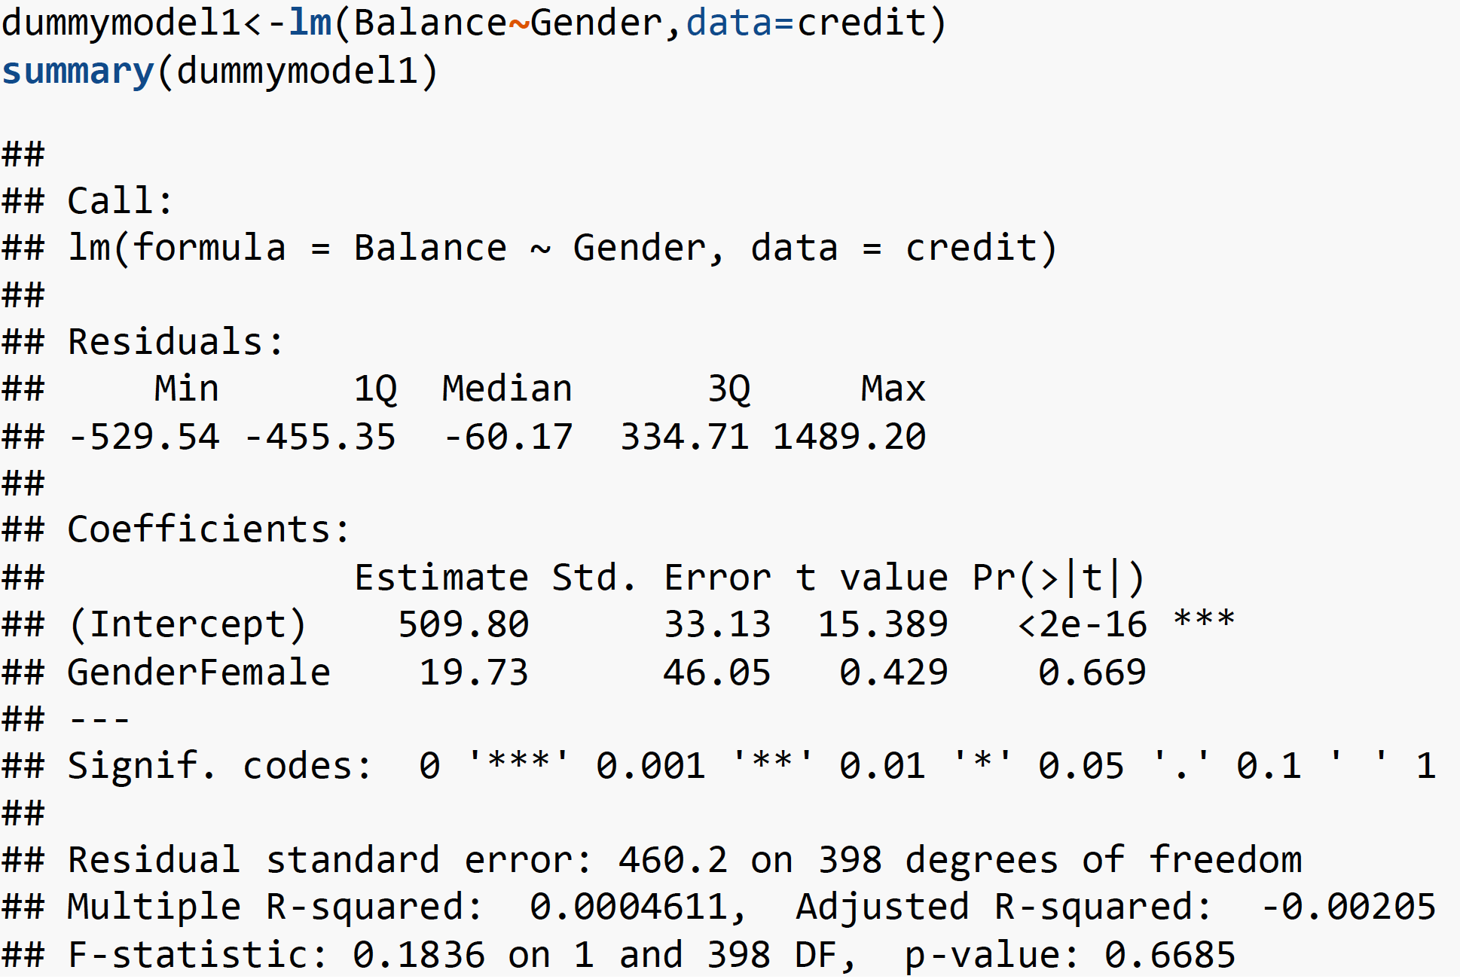

Slide 14
Understand the model

Slide 15
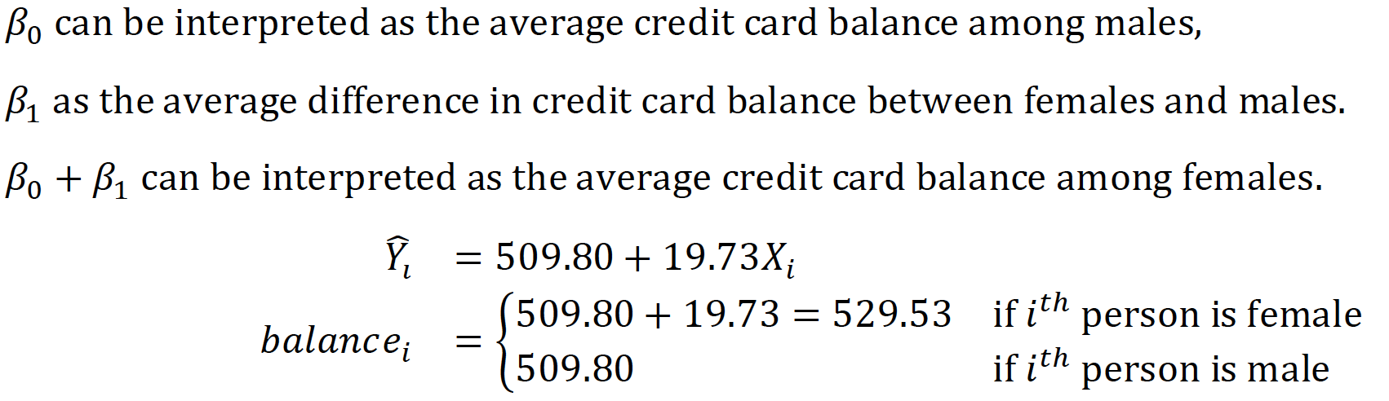
Interpreting coefficients of predictor variable

Slide 16
In-class Practice Problem #6

Slide 17
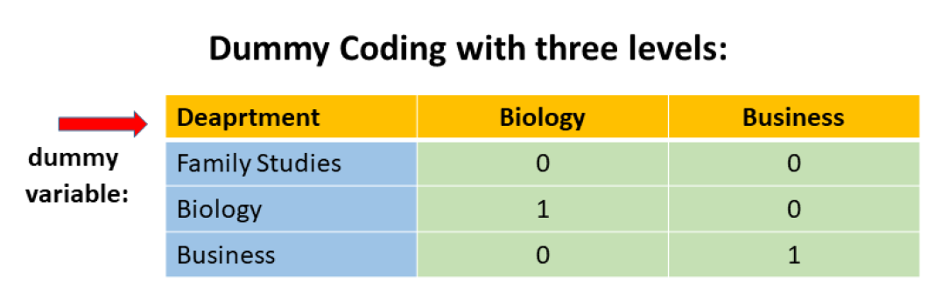
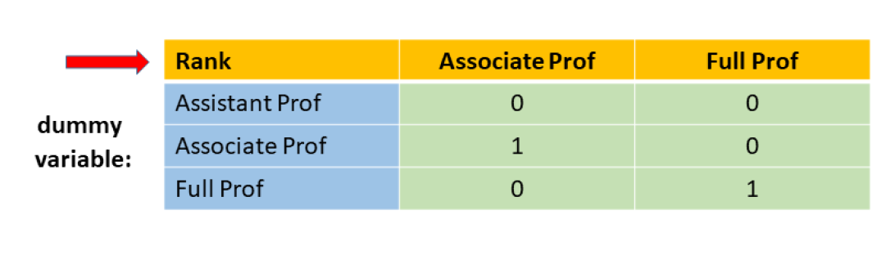
Dummy Coding with three levels

Slide 18
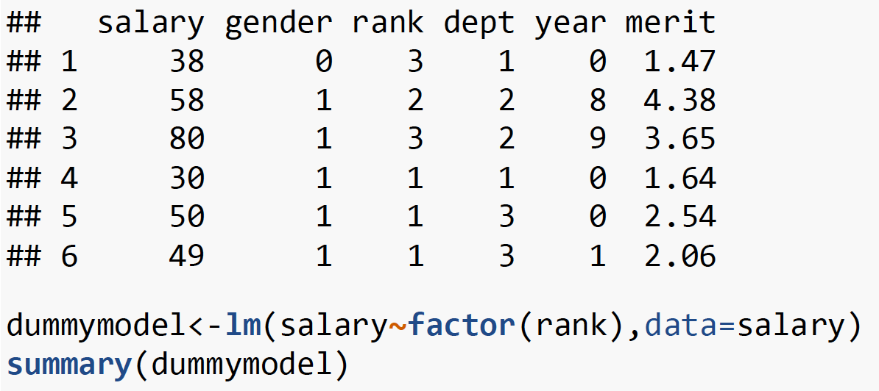

Slide 19
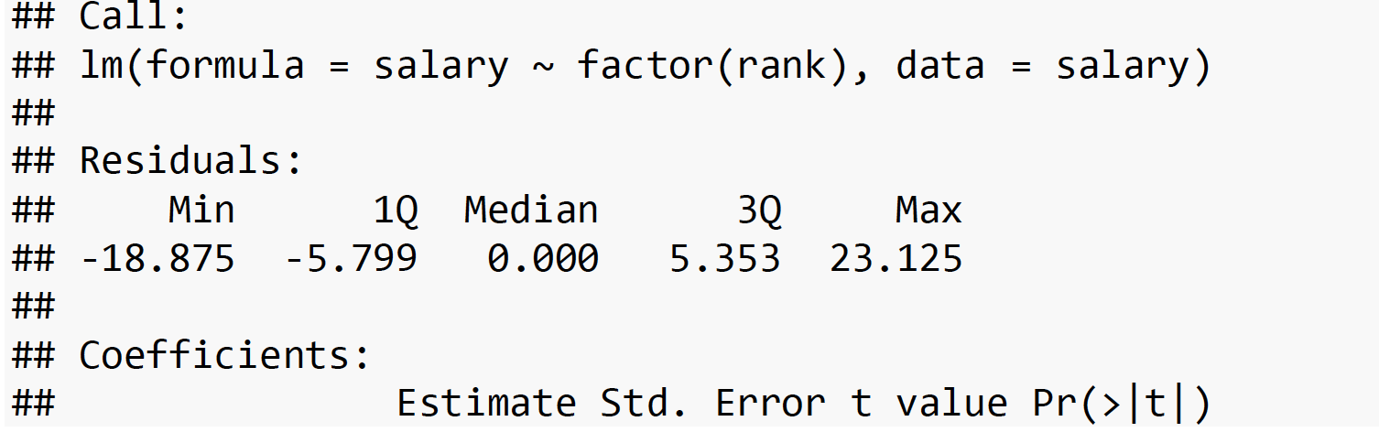
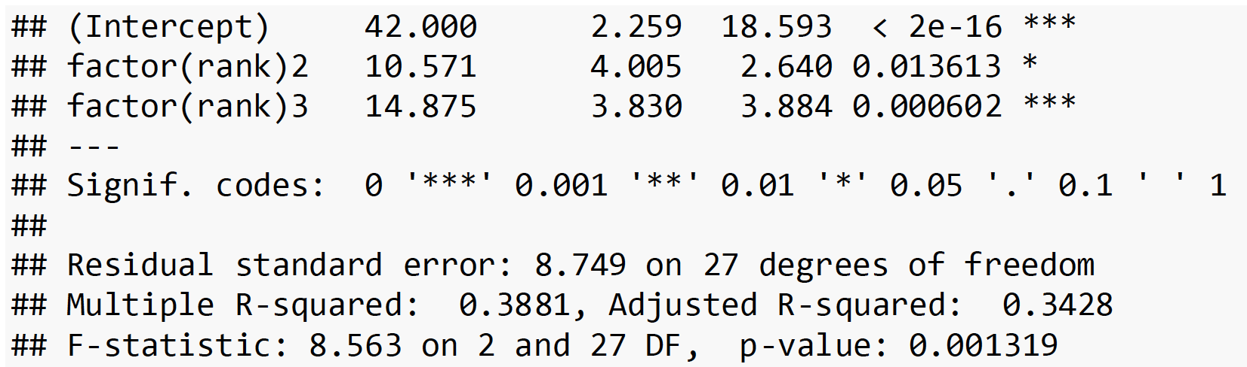

Slide 20
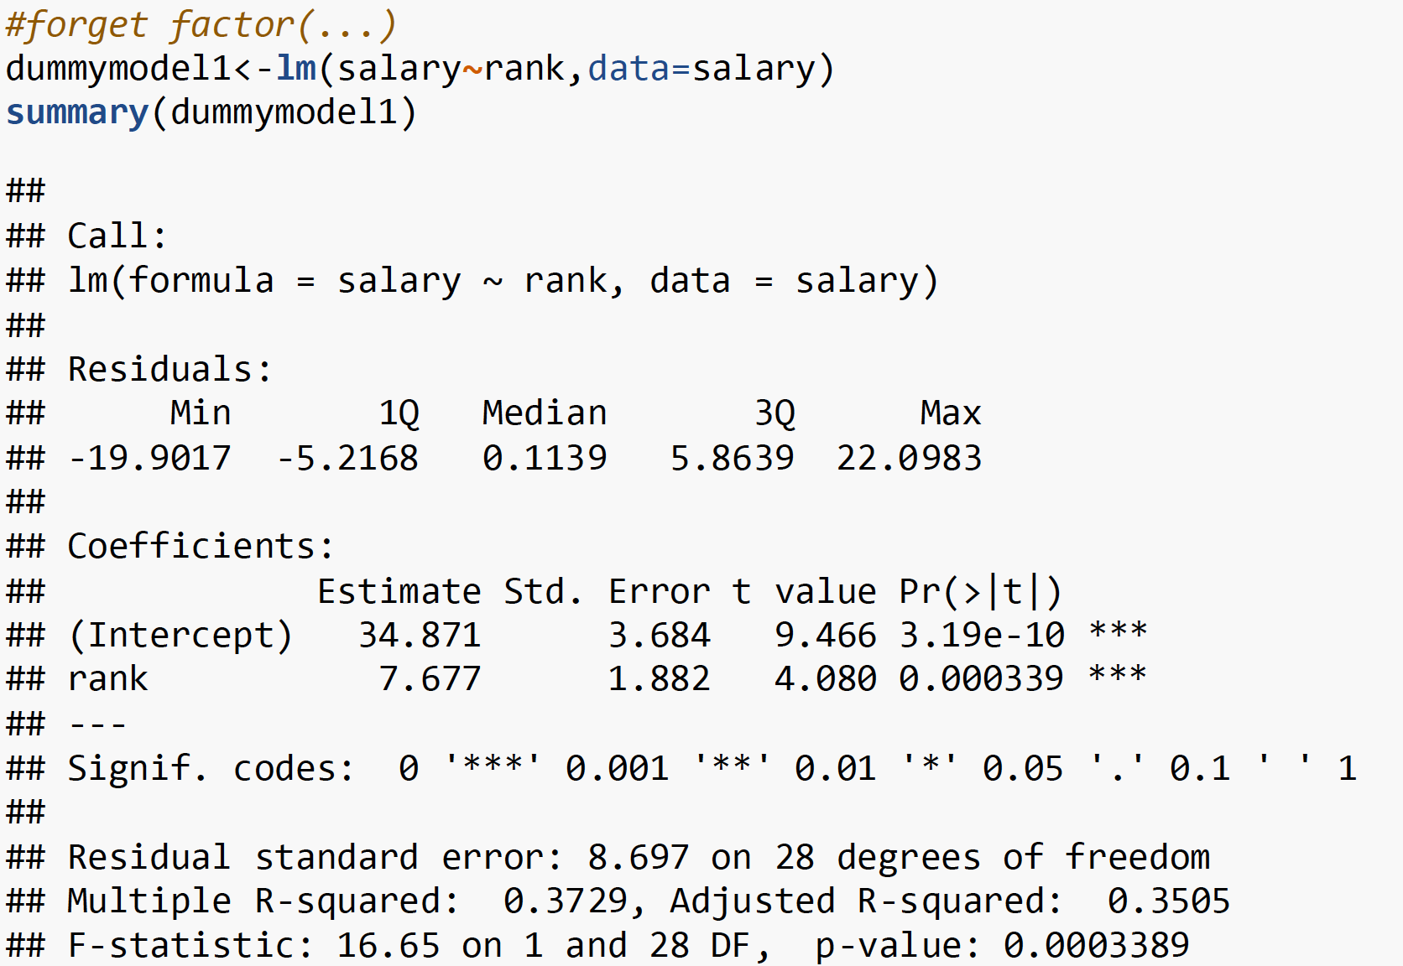

Slide 21
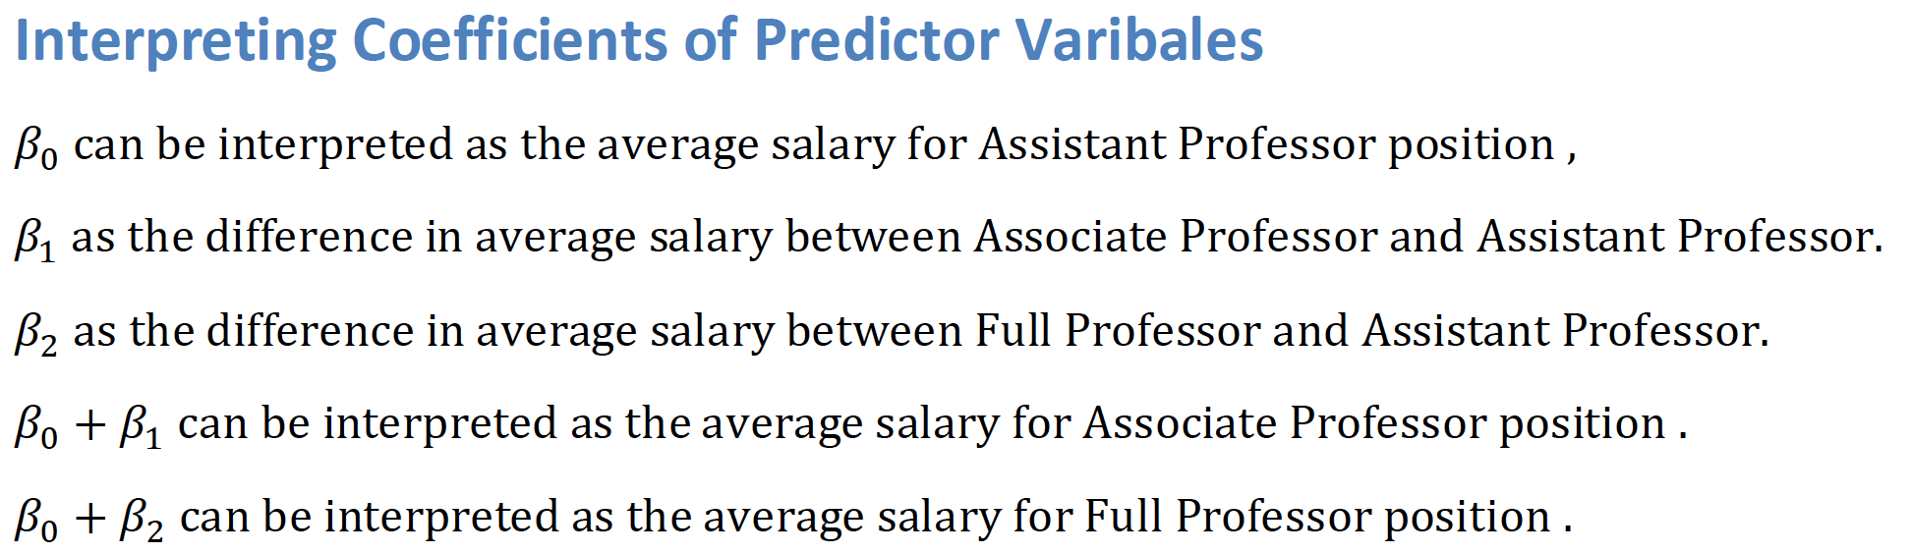


Slide 22
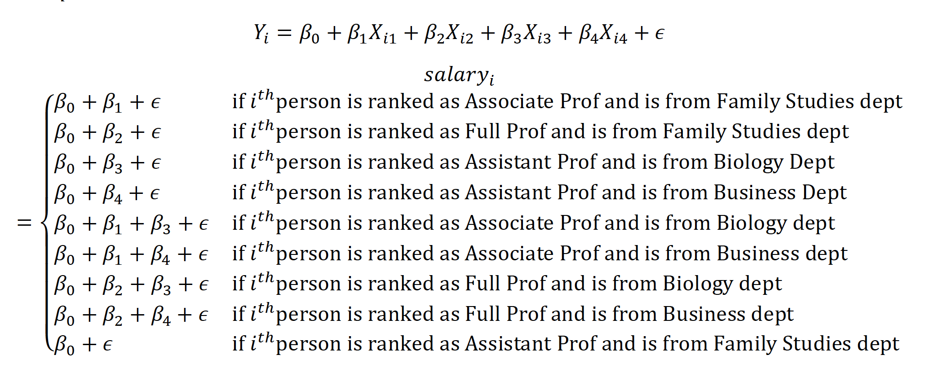
Explain the model

Slide 23
In-class Practice Problem #7

Slide 24
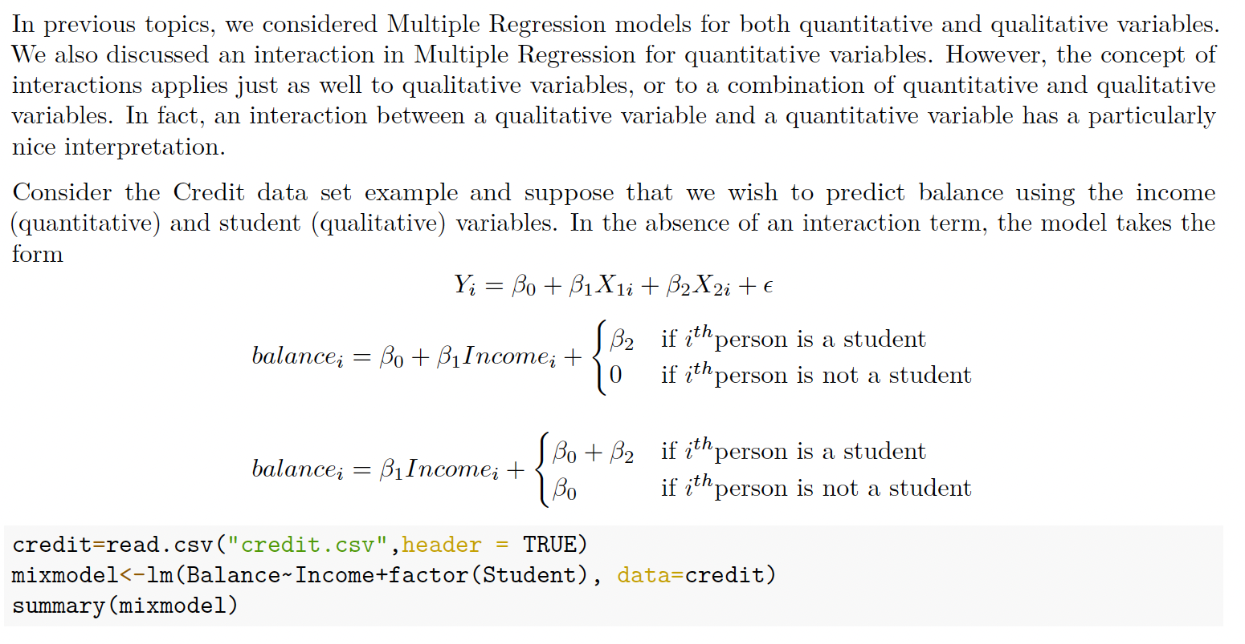
Interaction Effect in Multiple Regression with both Quantitative and Qualitative (Dummy) Variable models

Slide 25
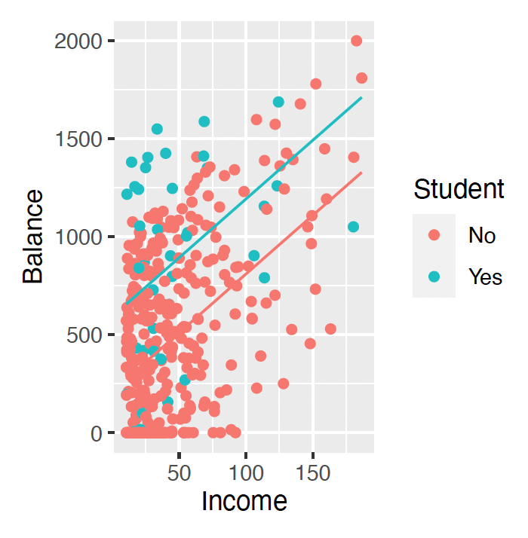
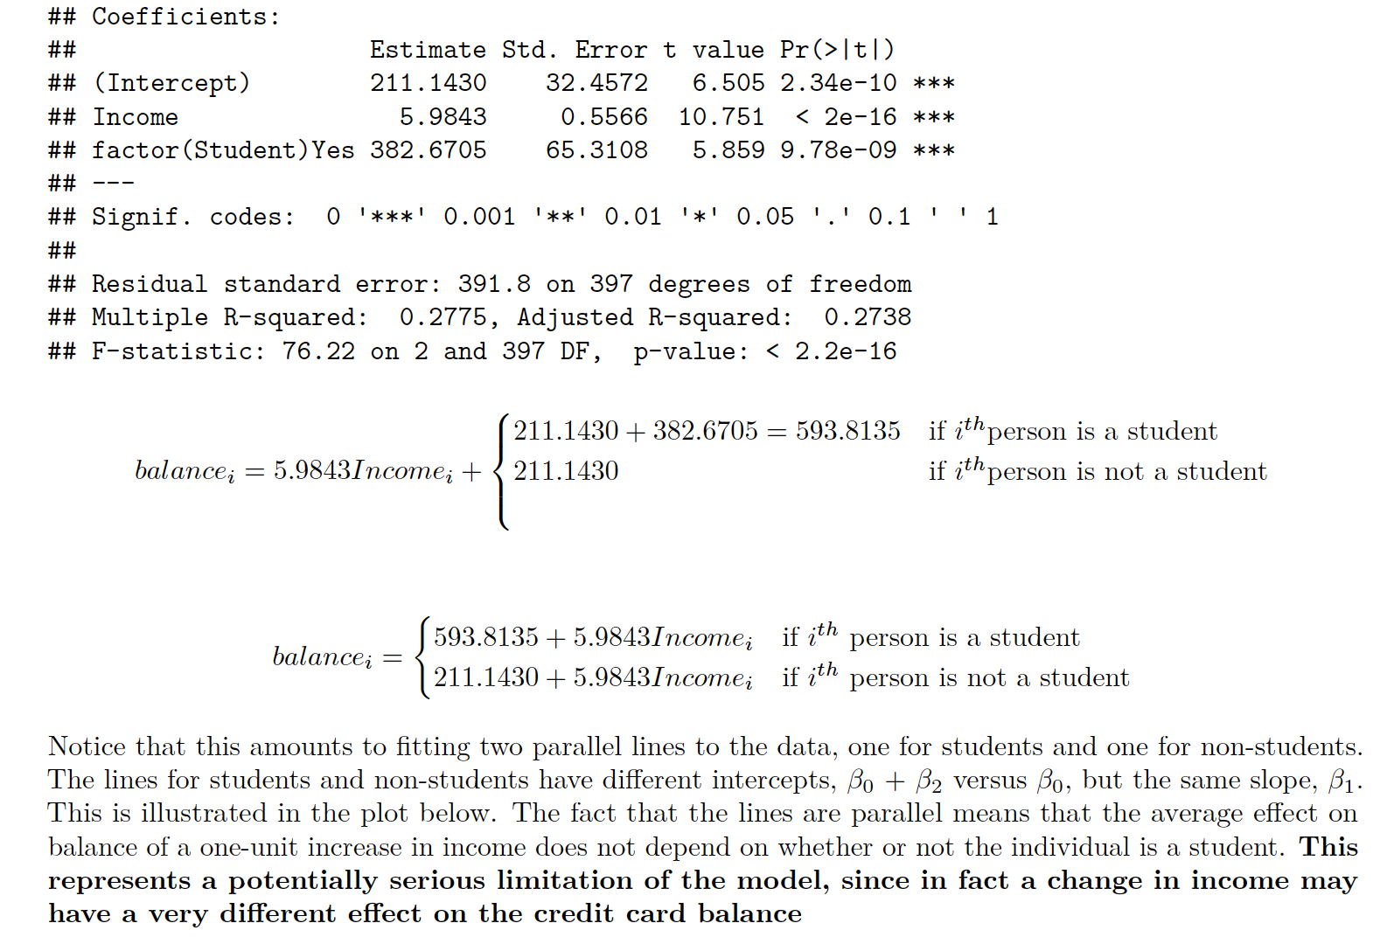
Interaction Effect in Multiple Regression with both Quantitative and Qualitative (Dummy) Variable models

Slide 26
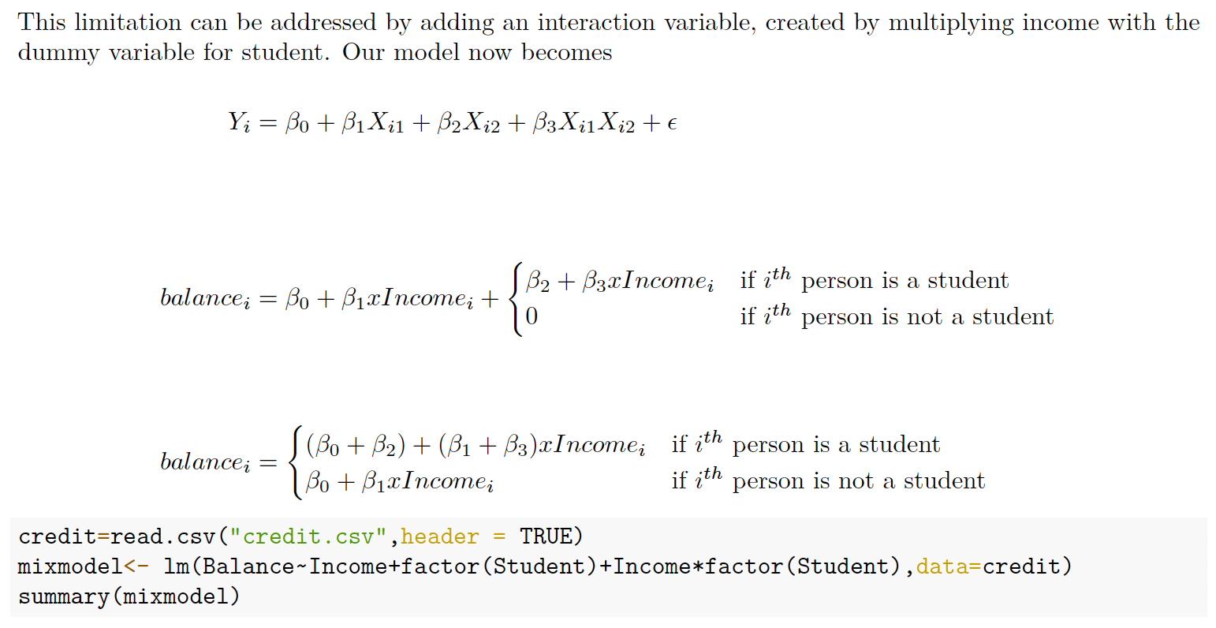
Interaction Effect in Multiple Regression with both Quantitative and Qualitative (Dummy) Variable models

Slide 27
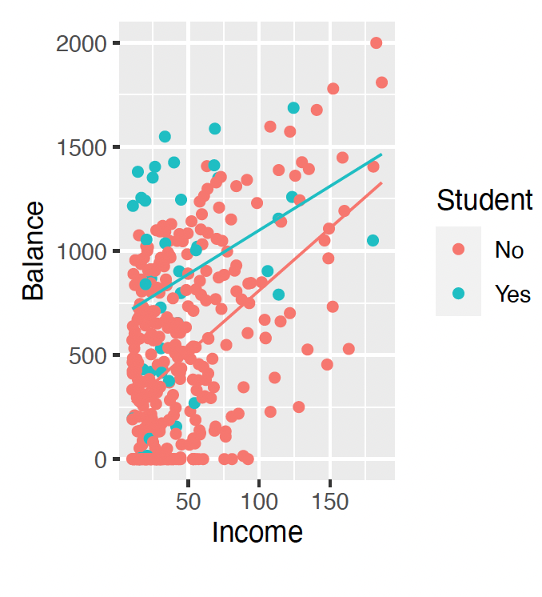
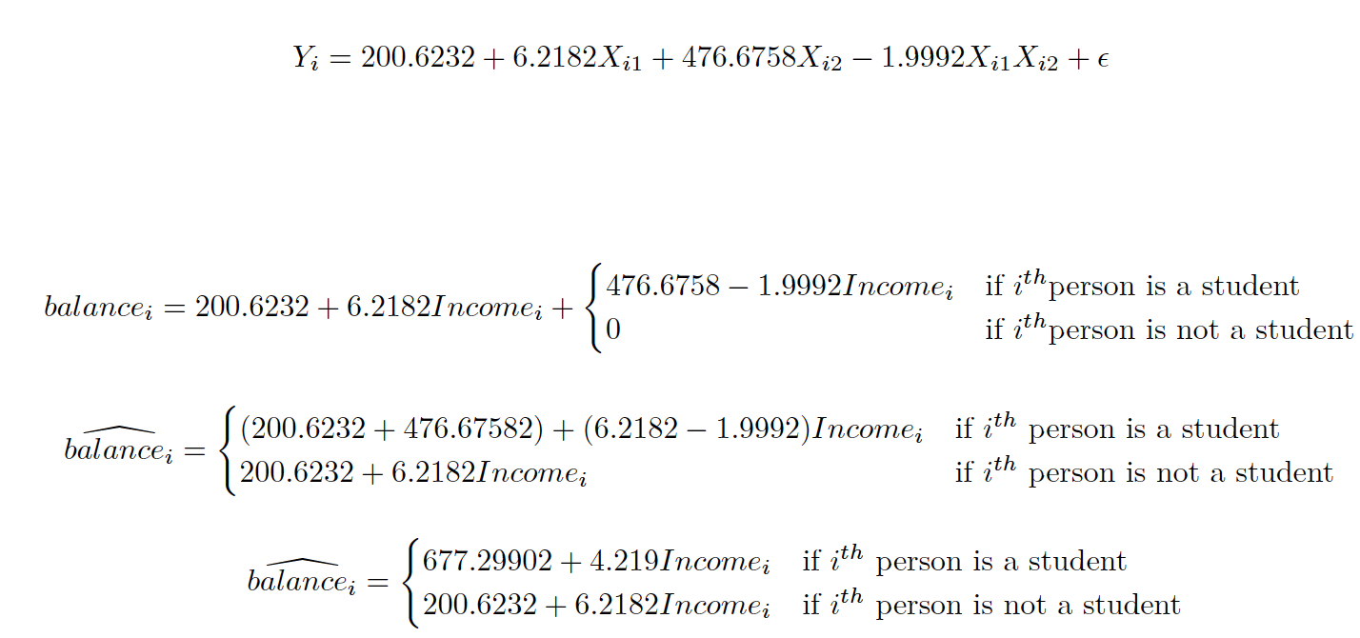
Interaction Effect in Multiple Regression with both Quantitative and Qualitative (Dummy) Variable models

Slide 28
In-class Practice Problem #8

Slide 29
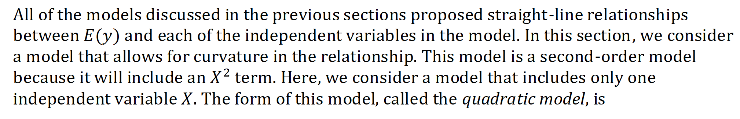
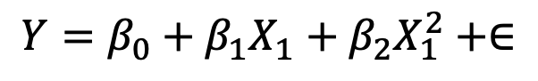
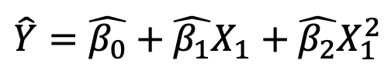
A Quadratic (Second Order) Model with Quantitative predictors
$$Y=β_{0}+β_{1}X_{1}+β_{2}X_{1}^{2}+∈$$
$$\hat{Y}=\hat{β_{0}}+\hat{β_{1}}X_{1}+\hat{β_{2}}X_{1}^{2}$$
How to interpret the regression coefficients?
How to let R know we are putting higher order term?

Slide 30
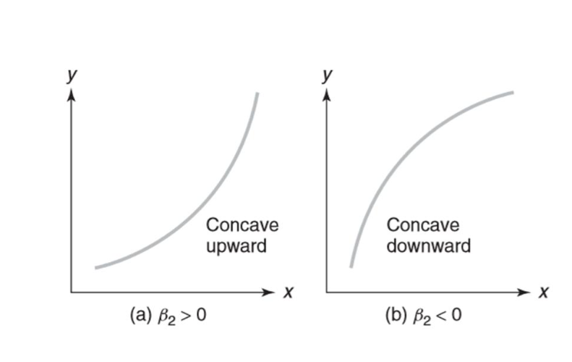

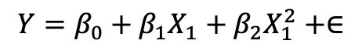
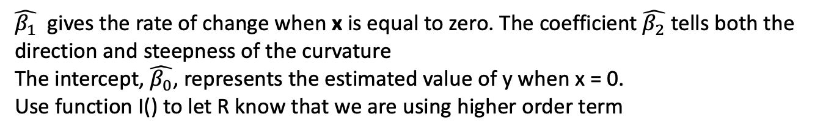
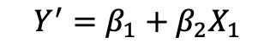
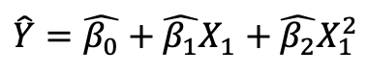
Interpretation of the regression coefficients
$$Y=β_{0}+β_{1}X_{1}+β_{2}X_{1}^{2}+∈$$
$$\hat{Y}=\hat{β_{0}}+\hat{β_{1}}X_{1}+\hat{β_{2}}X_{1}^{2}$$
Differentiate with respect to x
$$Y^{′}=β_{1}+β_{2}X_{1}$$
$\hat{β_{1}}$ gives the rate of change when x is equal to zero. The coefficient $\hat{β_{2}}$ tells both the direction and steepness of the curvature
The intercept, $\hat{β_{0}}$, represents the estimated value of y when x = 0.
Use function I() to let R know that we are using higher order term
ABC convex, concave up

Slide 31
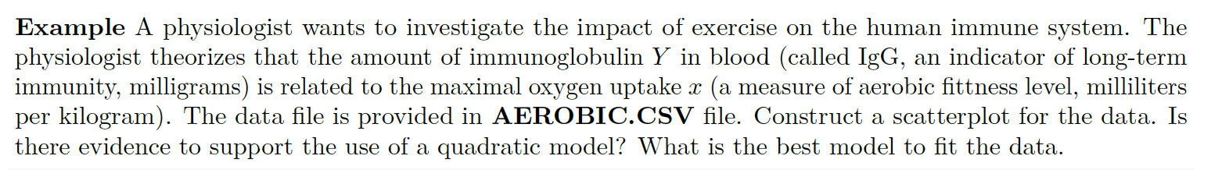
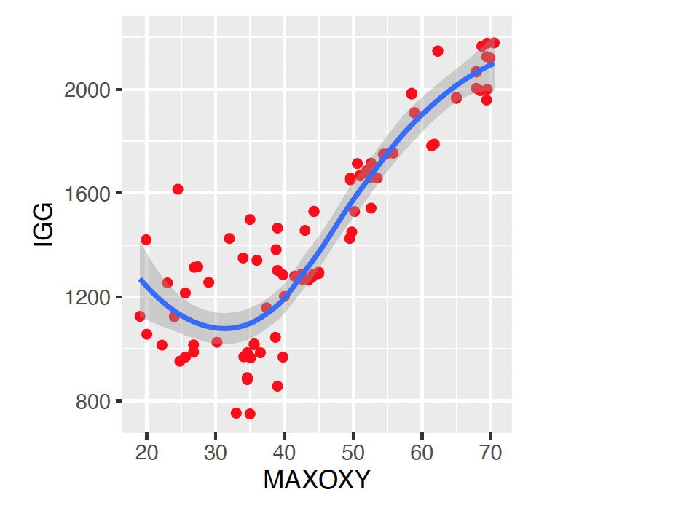
Example: obviously nonlinear

Slide 32



Higher-order models

Slide 33
In-class Practice Problem #9

